Slide 1
ISED’s Agile Journey

Slide 2
Current State
2

Slide 3
What does success look like?
On-time? On-budget? Scope?
Notes:
If your next project were on-time, on-budget and deliver 100% of the scope you wanted, would it be a success?
What if no one uses your product? Still a success?

Slide 4
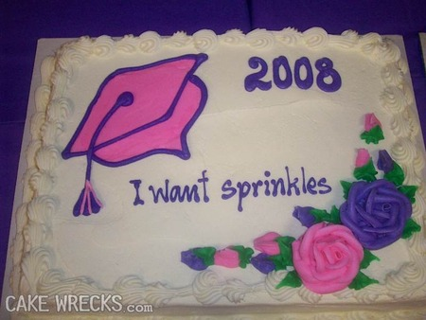
Communication
Source: https://www.cakewrecks.com/home/2008/10/11/sorry-you-cant-have-any.html

Slide 5
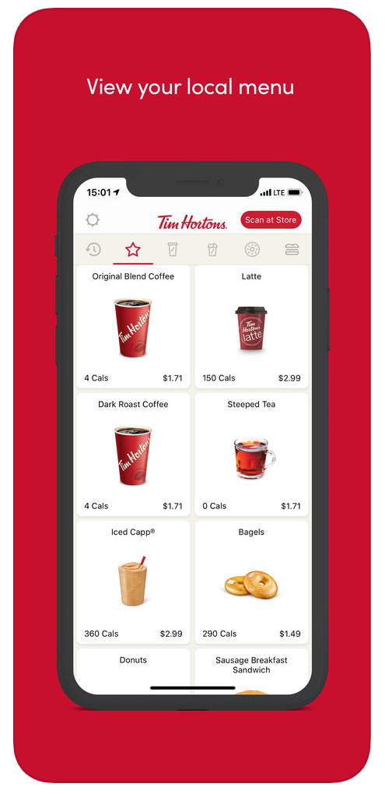
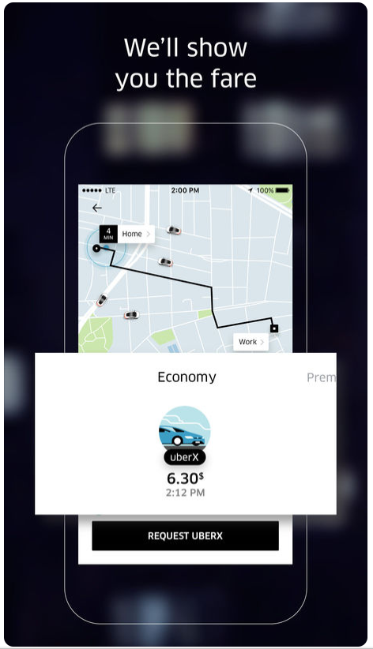
Why Agile?
Raised expectations
Rapid change
Notes:
WHY Agile?
Better business outcomes in the face of rapid change!
Citizens’ are having incredible digital experiences from digitally savvy organizations
Focus on the outcomes. At the end of the timeline and budget, make an ROI decision. Do we continue investing?
The world is evolving too rapidly to take too much time building systems. Governance – 5 year cycle (on average)

Slide 6

Exercise: Traits of great teams

Slide 7
The Science of Productivity
7

Slide 8
Individual vs team performance
10:1
2,000:1
Notes:
A Yale study asked, how much effort goes into getting an “A”. Turned out, students can get an “A” with varying degrees of effort. The spread between the slowest and fastest individual obtaining an “A” was 10:1.
A similar study was conducted with 3,800 teams. The spread in speed between teams that achieved their objectives was 2,000:1.
Teams are much more complex to manage!

Slide 9
Successful Teams
Purpose
Autonomous
Cross-Functional
Success

Slide 10
Task Switching
Number of simultaneous projects | Percent of time available per project (all projects) | Loss to context switching
1 | 100% (100%) | 0%
2 | 40% (80%) | 20%
3 | 20% (60%) | 40%
4 | 10% (40%) | 60%
5 | 5% (25%) | 75%
Source: Quality Software Management, Gerald Weinberg

Slide 11
Team Size
7
^{+/-}2
Notes:
Various research papers out on this.
Newer research shows a lower number, ideally, 4-7.
This is all due to the number of relationships on the team and the true communication that is occurring.

Slide 12
Traditional Methods & Agile Behaviours
Management Method used | Less Agile | More Agile
Agile | 18.6% | 81.4%
Traditional | 62.2% | 37.8%
Hybrid | 30.4% | 69.6%
Source: Project Management Agility Global Survey. Massachusetts Institute of Technology, Consortium for Engineering Program Excellence – CEPE, Cambridge Massachusetts, USA
Notes:
Regardless of the method used, some agile values and principles are demonstrated in all organizations.
You can exhibit agile values and behaviours in a traditional Project Management structure. Don’t let a waterfall governance structure stop you from taking the first step!

Slide 13
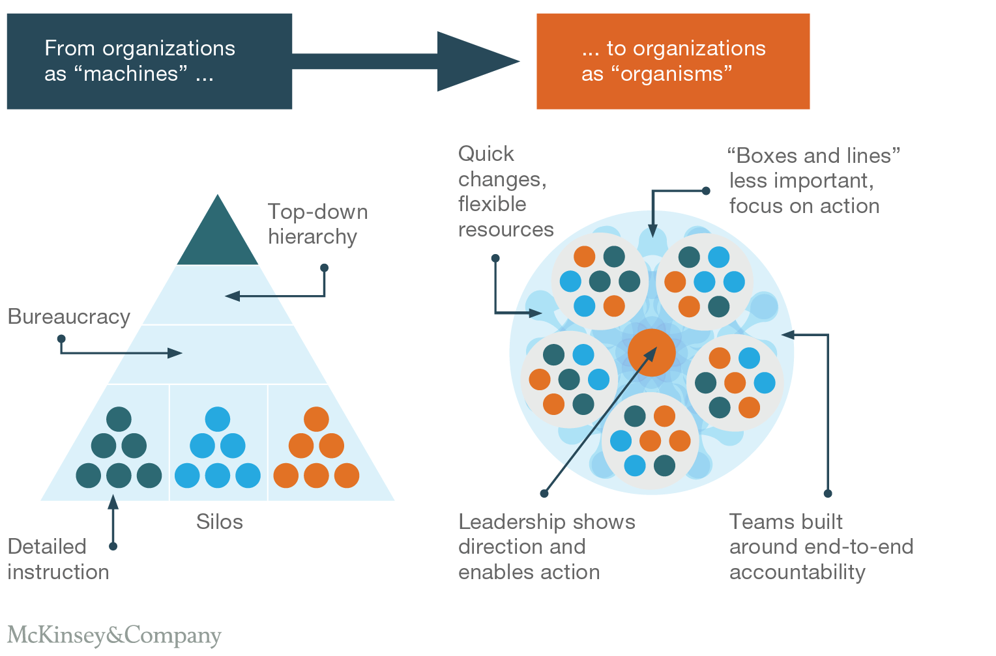
The agile organization
Source: https://www.mckinsey.com/business-functions/organization/our-insights/the-five-trademarks-of-agile-organizations?reload
Notes:
A true agile organization may be challenging to implement in government BUT.
Leadership shifts to a focus on strategic direction, alignment, and outcomes
Cross functional teams are empowered to make data-driven decisions to realize the outcomes

Slide 14

It’s about the system
Notes:
Edward Demming’s research uncovered that 94% of defects in manufacturing were due to system problems not people problems.
Constantly introspect how your organization is setup (what incentives and processes are in place) rather than blame individuals
Netflix story to illustrate.

Slide 15
What is agile?
Mindset
We are a self improving learning organization that does the right thing
Values
We are an autonomous, cross functional team that trusts each other
Principles
We deliver working software every sprint for our customers’
Practices
We use the Scrum methodology to guide us on our agile journey
Frameworks and tools
We use Jira, Axure, and HTML
Less visible; Most Powerful
Most visible; Least Powerful
Notes:
Agile is more than just a process or a set of tools.
It’s a change in mindset.

Slide 16
ISED’s Journey
16

Slide 17
Early days
Sprints
Standups
Continuous integration
Success with Scrum
2009
2018

Slide 18
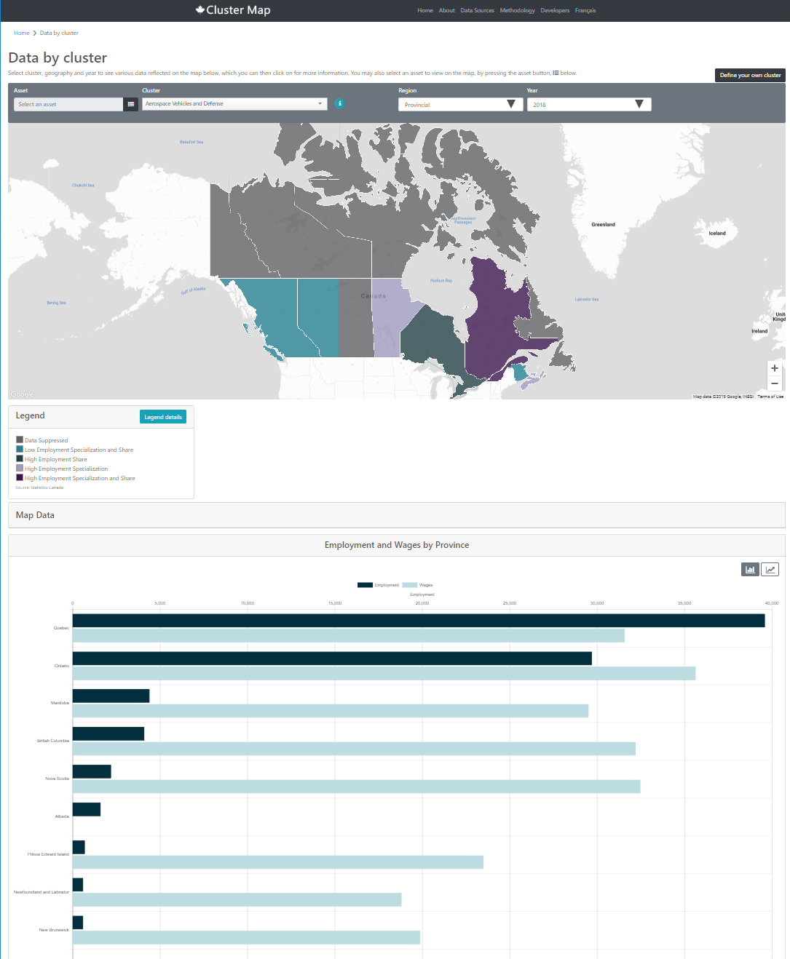
Success – Cluster Map
On-time
On-budget
Happy users
Happy partner
Happy team

Slide 19

Aneeta Bains
Chief Digital Officer and Assistant Deputy Minister
Digital Transformation Service Sector

Slide 20
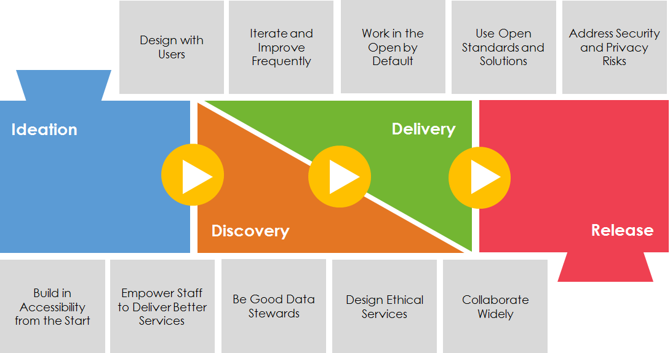
Digital Playbook
Notes:
Engaged Deloitte to help us on our Agile journey

Slide 21
Where did we start?
Lean coffee
CoP
Governance
Communication
Digital Government for Business
Education
Coaching
Self-assessment
Digital Playbook
Team bootcamps
Executive Awareness
4 initiatives
Workshops
Awareness
Consultations
Involved teams
Notes:
We’re learning, iterating, and improving
Acknowledge we may not get it right the first time

Slide 22
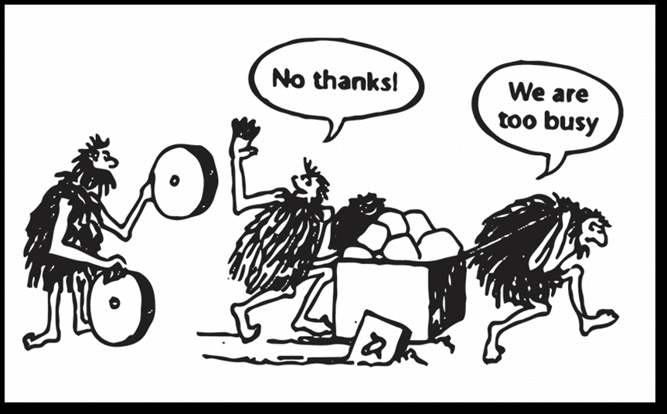
What to expect
Source: https://tenmilesquare.com/when-is-the-right-time-to-innovate-your-business/

Slide 23
What to expect
Time
Mindset not process
Cross-functional teams
Behaviour modeling
Finding and developing skills (PO, SM)
Desire to start large
Governance mindset - meetings

Slide 24
What to expect
“We can’t be agile because of governance”
“We’re already are agile, we do sprints and standups”
Education is not enough! Need to coach teams through the changes.

Slide 25
Lessons learned
Invitation
Start small, actually, just start
Regular improvement, not perfection
Positive re-inforcement
Learn and grow
Open space. Lean coffee.
Executive sponsorship
Audit – Risk management

Slide 26
Lessons learned
Focus. Teams start too big.
Free placemats. Dandypeople.com
Psychological safety

Slide 27
Your Journey
27

Slide 28
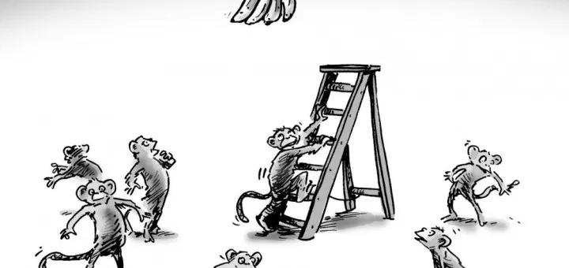
Your journey

Slide 29
Your journey
Start small. Actually, just start!
Notes:
Make small changes, then advocate for larger changes.
In my experience, TBS is more open to changes than in our own department. We fear something that doesn’t need to be feared. There’s an appetite for change, let’s seize it.

Slide 30
Appendix
30

Slide 31
Exercise: Nickel Sprint

Slide 32

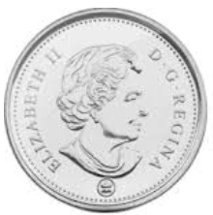
Exercise : Nickel Sprint
5 member agile team
1 Client (Product Owner)
4 Team Members
Team Members
Flip the defined number of coins
Move the coins to the next team member
Client
Times coin “delivery”

Slide 33
What Did We Observe?
Same number of coins and workers each sprint
Overall time is reduced with smaller batches
Less waiting (down time) and more working with smaller batches
The time to first delivery goes way down
Doing the same task a few times leads to proficiency

